Slide 1
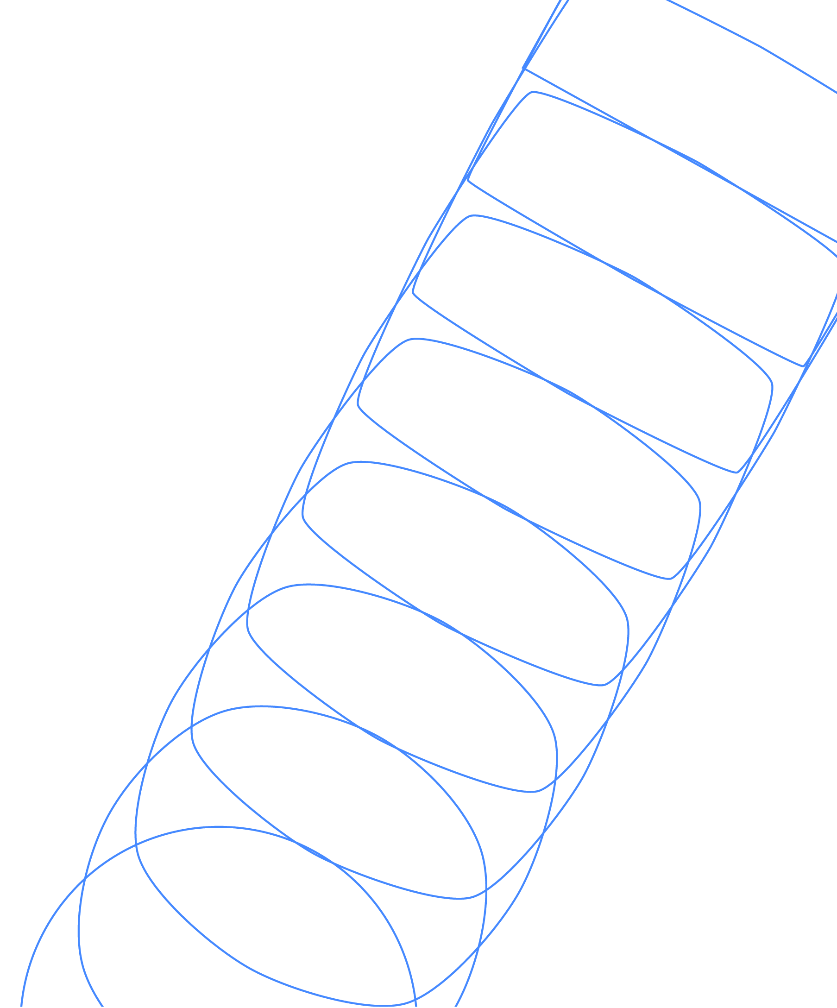
Introduction to the Surface Code
James R. Wootton
IBM Quantum

Slide 2
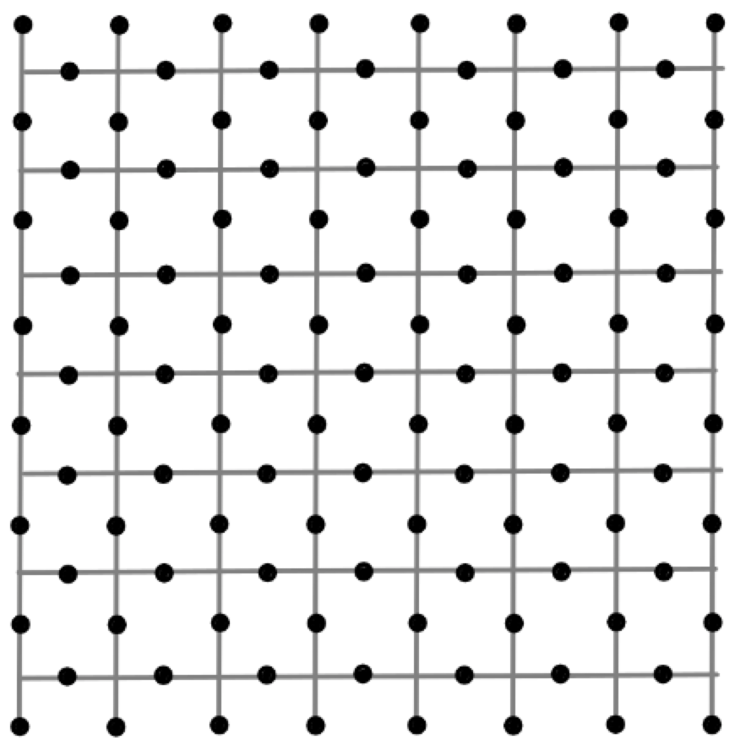
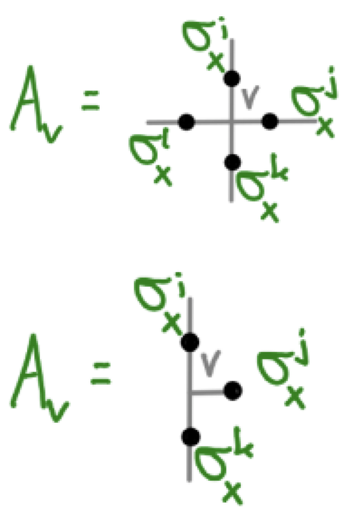
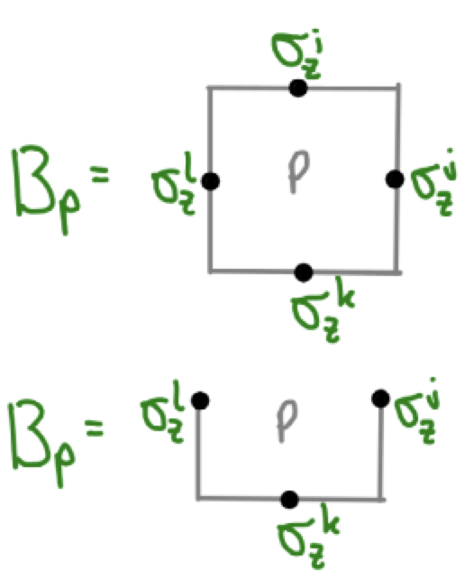
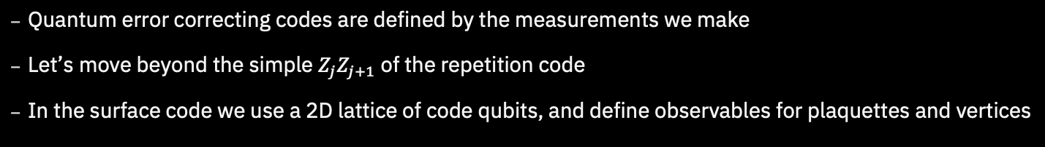
The Surface Code
Quantum error correcting codes are defined by the measurements we make
Let’s move beyond the simple $Z_{j}Z_{j+1}$ of the repetition code
In the surface code we use a 2D lattice of code qubits, and define observables for plaquettes and vertices

Slide 3
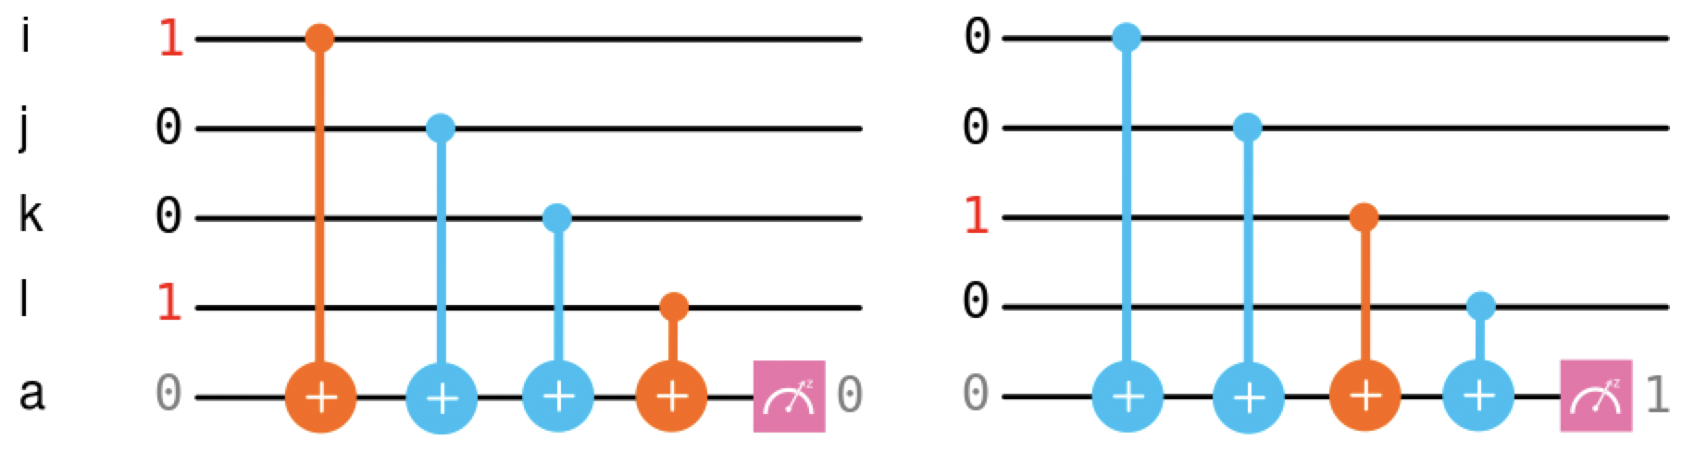
Plaquette Syndrome
First let’s focus on the plaquette syndrome
These are similar to the two qubit measurements in the repetition code
Instead we measure the parity around plaquettes in the lattice
Can again be done with CX gates and an extra qubit

Slide 4
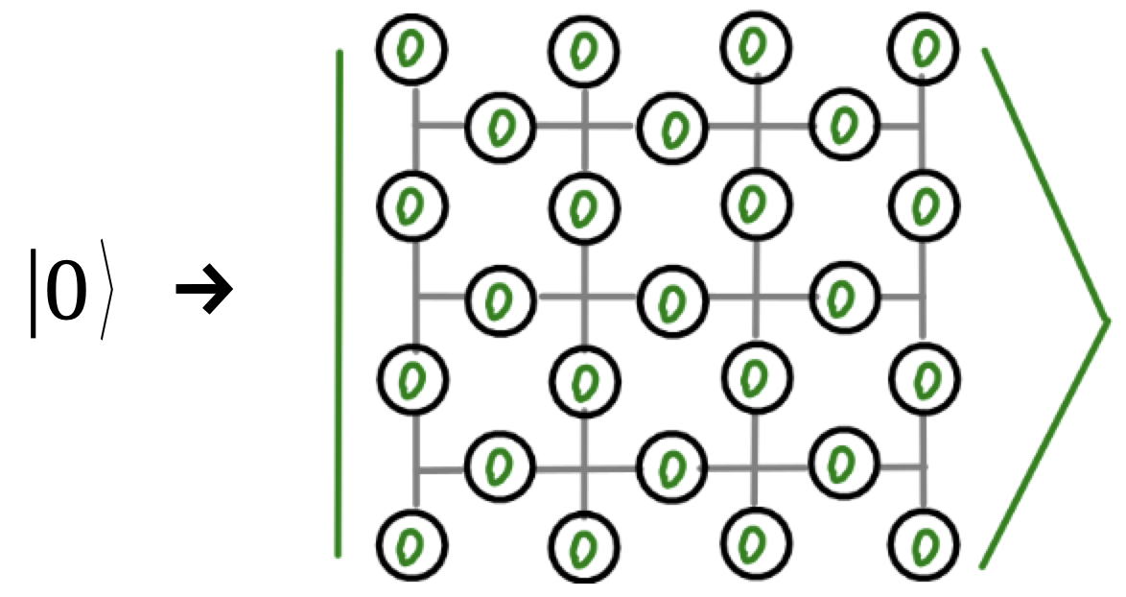
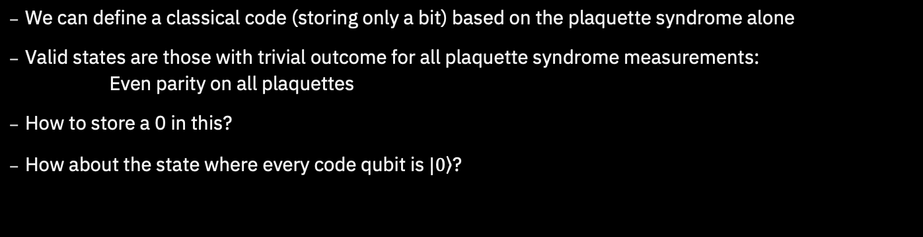
Plaquette Syndrome
We can define a classical code (storing only a bit) based on the plaquette syndrome alone
Valid states are those with trivial outcome for all plaquette syndrome measurements: Even parity on all plaquettes
How to store a 0 in this?
How about the state where every code qubit is $|\left.0\right\rangle$?

Slide 5
Plaquette Syndrome
We can define a classical code (storing only a bit) based on the plaquette syndrome alone
Valid states are those with trivial outcome for all plaquette syndrome measurements: Even parity on all plaquettes
How to store a 0 in this?
How about the state where every code qubit is $|\left.0\right\rangle$?

Slide 6
Plaquette Syndrome
We can define a classical code (storing only a bit) based on the plaquette syndrome alone
Valid states are those with trivial outcome for all plaquette syndrome measurements: Even parity on all plaquettes
How to store a 0 in this?
How about the state where every code qubit is $|\left.0\right\rangle$?

Slide 7
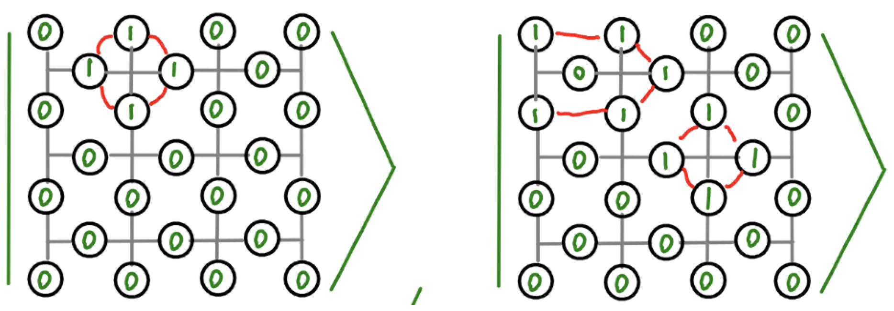
Plaquette Syndrome
There are ‘nearby’ states that also have even parity on all plaquettes
These can’t be a different encoded state: they are only a few bit flips away from our encoded 0 state
We’ll treat them as alternative ways to store a 0

Slide 8
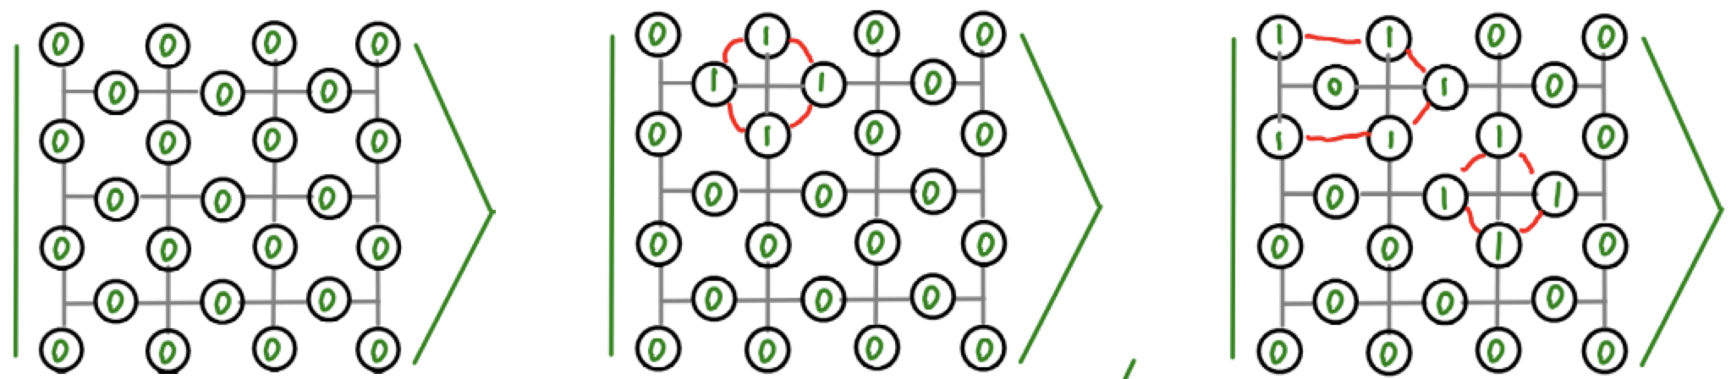
Plaquette Syndrome
Given any state for an encoded 0
Pick a vertex
Apply bit flips around that vertex
Now you have another valid state for 0
This generates an exponentially large family

Slide 9
Plaquette Syndrome
The states in this family can be very different
But they all share a common feature
Any line from top to bottom (passing along edges) has even parity
This is how we can identify an encoded 0
And it gives us a clue about how to encode a 1

Slide 10
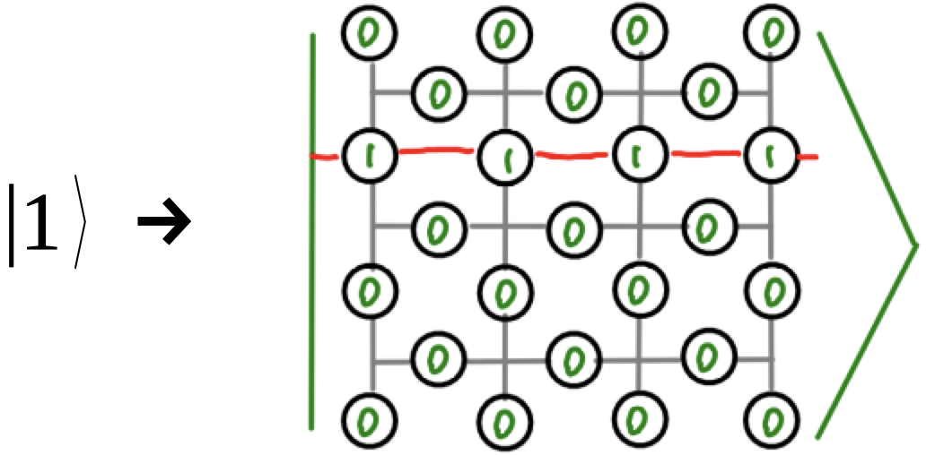
Plaquette Syndrome
For our basic encoded 1, we use a bunch of 0s with a line from left to right (passing through plaquettes)
This also spawns an exponentially large family
All have odd parity for a line from top to bottom
Unlike the repetition code, distinguishing encoded 0 and 1 requires some effort (which is good!)

Slide 11
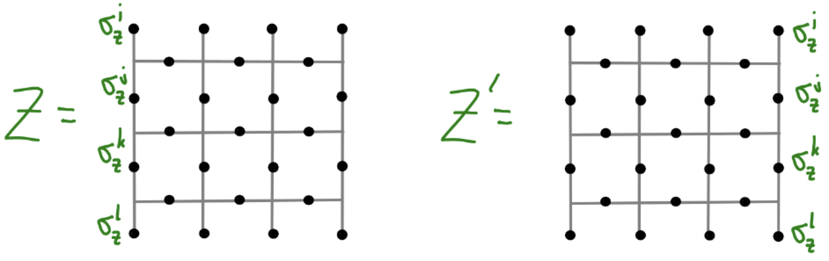
Logical X and Z
Distinguishing 0 and 1 corresponds to measuring Z on the physical qubit
The following observables detect what we need
Or the same on any line from top to bottom
Uses the edges has a nice advantage: we can think of them as large (unenforced) plaquettes

Slide 12
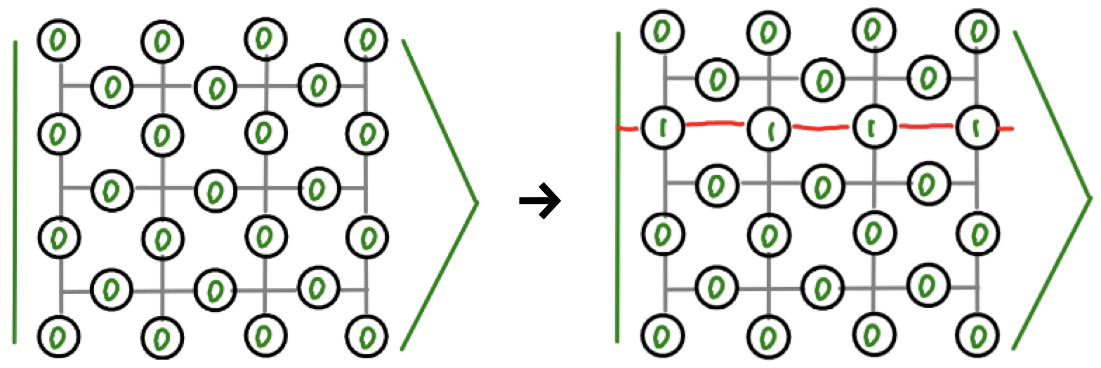
Logical X and Z
To flip between 0 and 1, we can flip a line of qubits
Such lines of flips act as an X on the logical qubit

Slide 13
Effects of Errors
Applying an X to any code qubit changes the parity of its two plaquettes
An isolated X creates a pair of defects
Further Xs can be move a defect, or annihilate pairs of them
A logical X requires many errors to stretch across the lattice
With the plaquette operators, we can encode and protect a bit

Slide 14
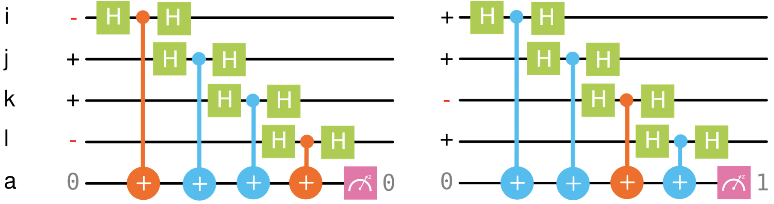
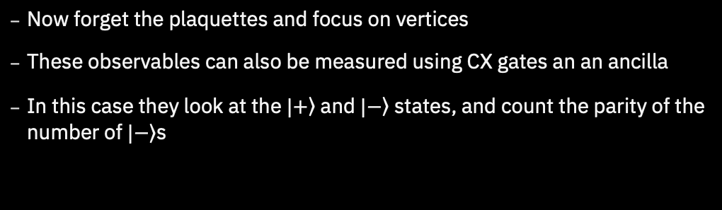
Vertex Syndrome
Now forget the plaquettes and focus on vertices
These observables can also be measured using CX gates an an ancilla
In this case they look at the $|\left.+\right\rangle$ and $|\left.−\right\rangle$ states, and count the parity of the number of $|\left.−\right\rangle$s

Slide 15
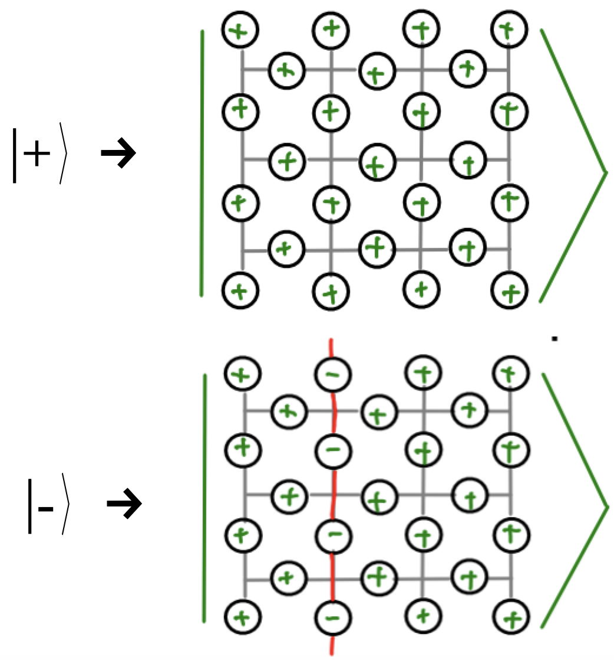
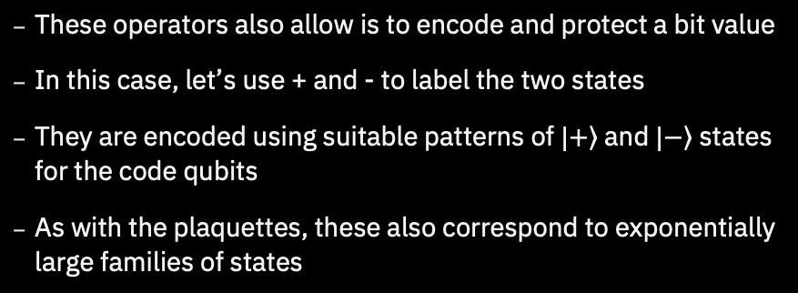
Vertex Syndrome
These operators also allow is to encode and protect a bit value
In this case, let’s use + and - to label the two states
They are encoded using suitable patterns of $|\left.+\right\rangle$ and $|\left.−\right\rangle$ states for the code qubits
As with the plaquettes, these also correspond to exponentially large families of states

Slide 16
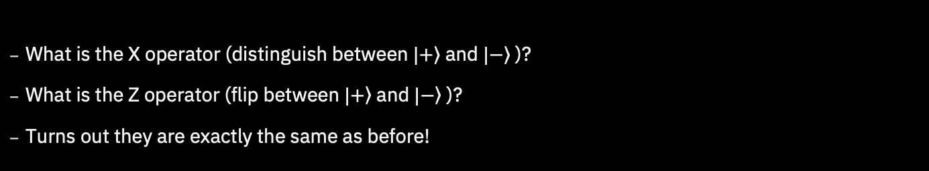
Logical X and Z
What is the X operator (distinguish between $|\left.+\right\rangle$ and $|\left.−\right\rangle$ )?
What is the Z operator (flip between $|\left.+\right\rangle$ and $|\left.−\right\rangle$ )?
Turns out they are exactly the same as before!

Slide 17
Effects of Errors
Applying a Z to any code qubit changes the X parity of its two vertices
An isolated Z creates a pair of defects
Further Zs can be move a defect, or annihilate pairs of them
A logical Z requires many errors to stretch across the lattice
With the vertex operators, we can encode and protect a bit

Slide 18
Putting it all Together
The plaquette and vertex operators commute
This allows us to detect both X and Z errors
Since Y~XZ, we can detect Y errors too

Slide 19
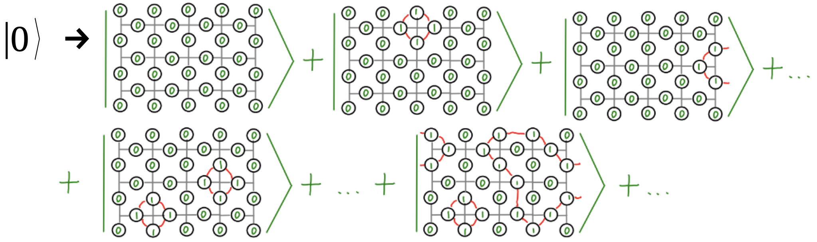
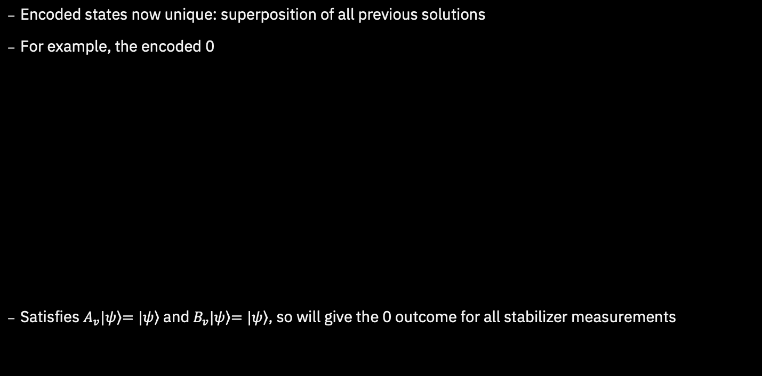
Putting it all Together
Encoded states now unique: superposition of all previous solutions
For example, the encoded 0
Satisfies $A_{v}|\left.ψ\right\rangle \left.=|ψ\right\rangle$ and $B_{v}|\left.ψ\right\rangle \left.=|ψ\right\rangle$, so will give the 0 outcome for all stabilizer measurements

Slide 20
Putting it all Together
The Z and X operators on the encoded qubit are exactly the same as before
These, and the Hadamard, can be performed fault-tolerantly

Slide 21
Putting it all Together
The states we need are highly entangled quantum states
They are examples of topologically ordered states
Though such things can be hard to make, we create and protect them with the syndrome measurements

Slide 22
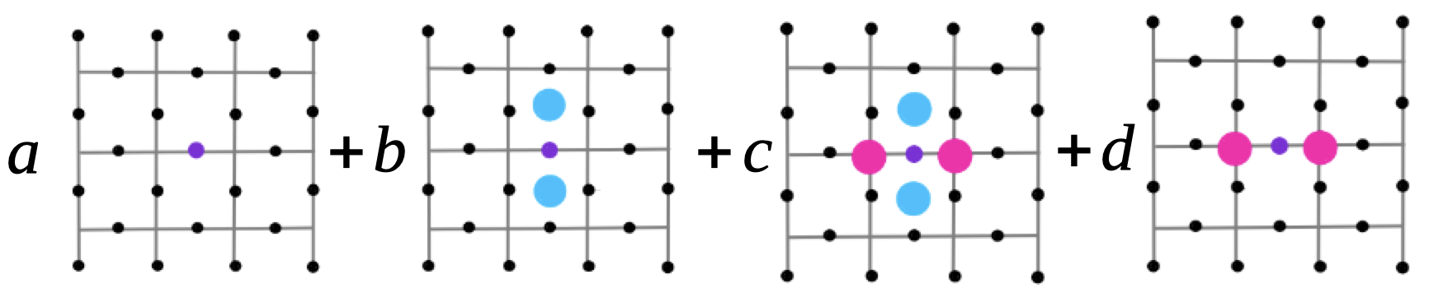
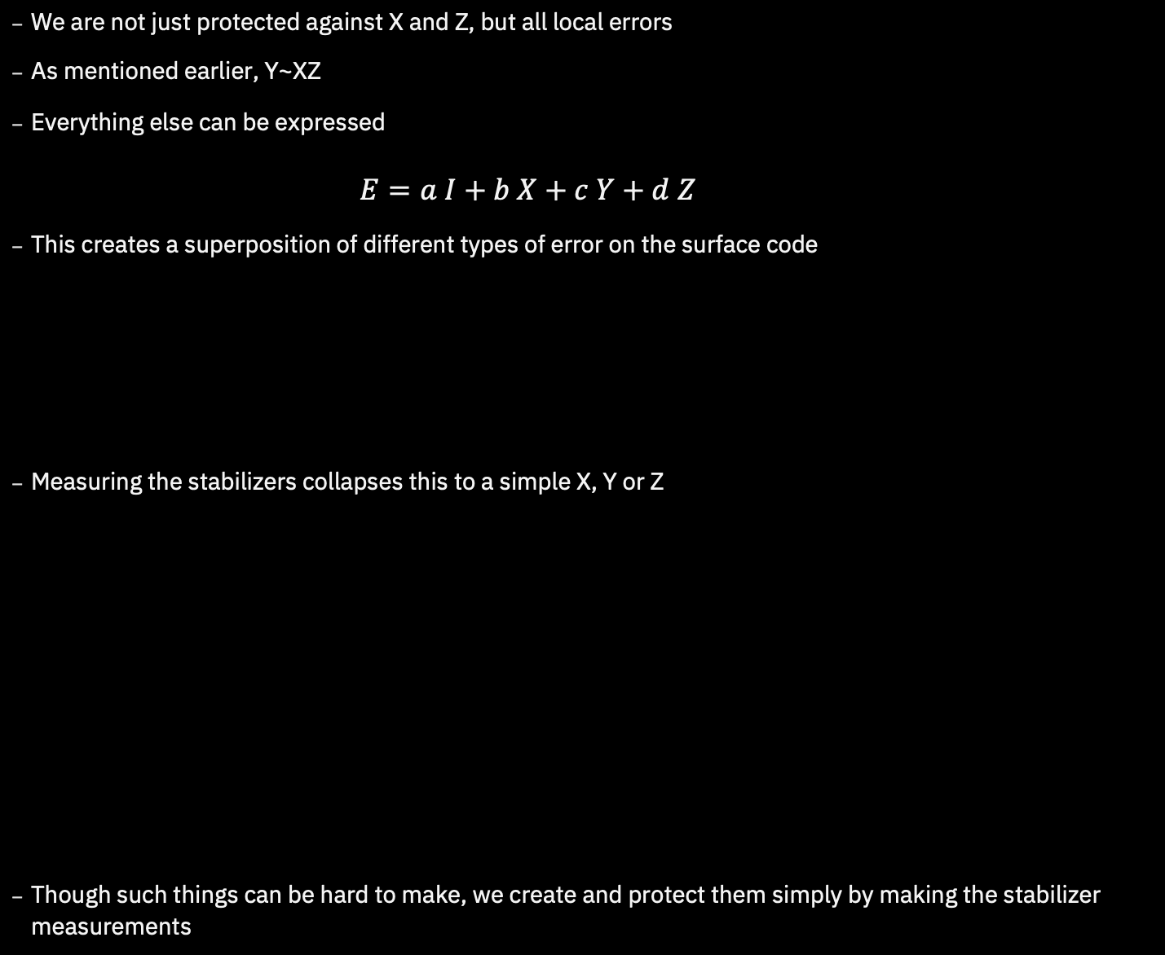
Putting it all Together
We are not just protected against X and Z, but all local errors
As mentioned earlier, Y~XZ
Everything else can be expressed
$$E=a I+b X+c Y+d Z$$
This creates a superposition of different types of error on the surface code
Measuring the stabilizers collapses this to a simple X, Y or Z
Though such things can be hard to make, we create and protect them simply by making the stabilizer measurements

Slide 23
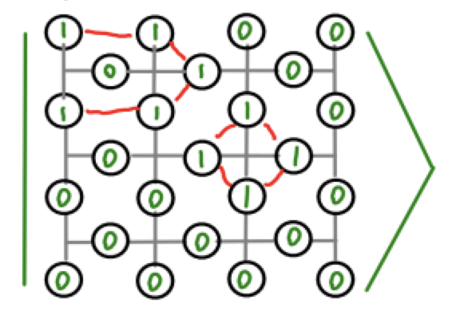
Final Readout
The logical operators are many-body observables
So how do we read them out fault-tolerantly
When you decide on a basis for final measurement, you stop caring about some errors
You can then measurement in a product basis
Final readout and final stabilizer measurement can be constructed from the result
Measurement errors are effectively the same as errors before measurement

Slide 24
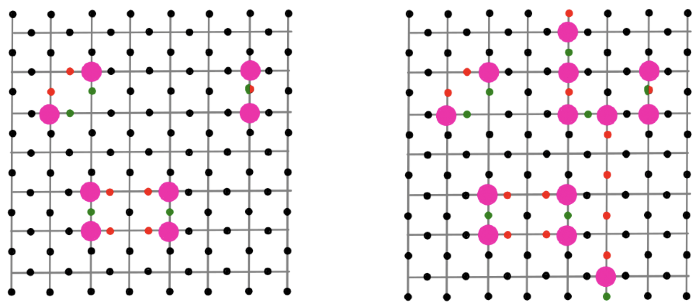
Decoding
Given the measurement results, we need to work out what errors happened
More specifically, the ‘equivalence class’ of errors
This is the job of the decoding algorithm

Slide 25
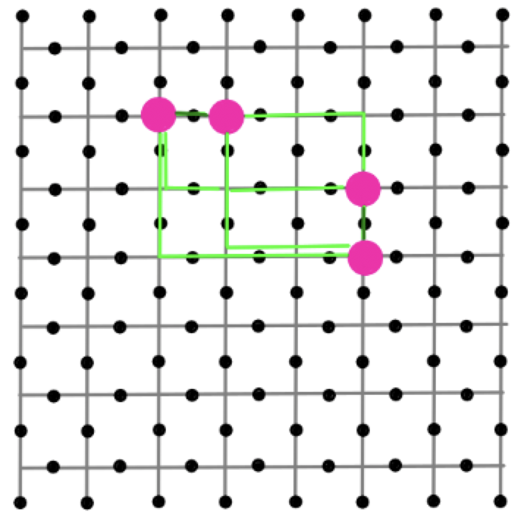
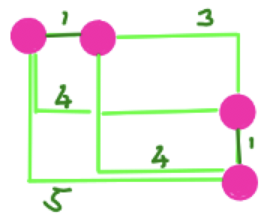
Decoding with MWPM
A good option is MWPM
Just as we considered for the repetition code
Again we start with the simple and unrealistic case: errors only between measurement
Each round can be decoded separately, corresponding to MWPM on a 2D graph
Decoding for X and Z errors can also be done independently

Slide 26
Decoding
We need to be careful to account for the effects of the edges
This is done by introducing extra ‘virtual nodes’ (also required for the repetition code, but we ignored it earlier)

Slide 27
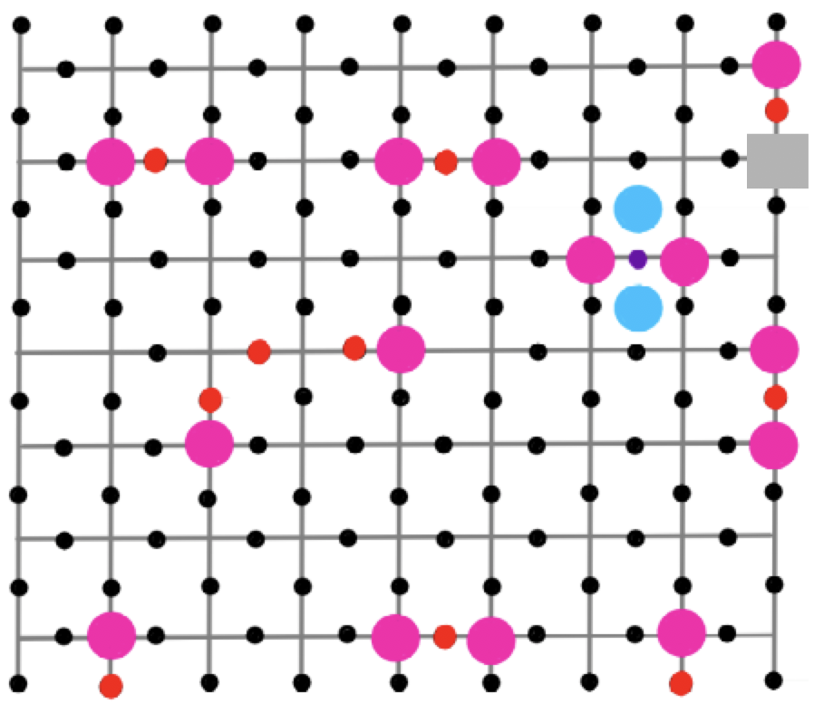
Imperfect Measurements
Again, we have the problem of imperfect measurements
The measurements might lie
Errors on the additional qubit
Errors in the CX gates
We base the decoding using syndrome changes
This leads to a 3D MWPM problem (2D space + time)

Slide 28
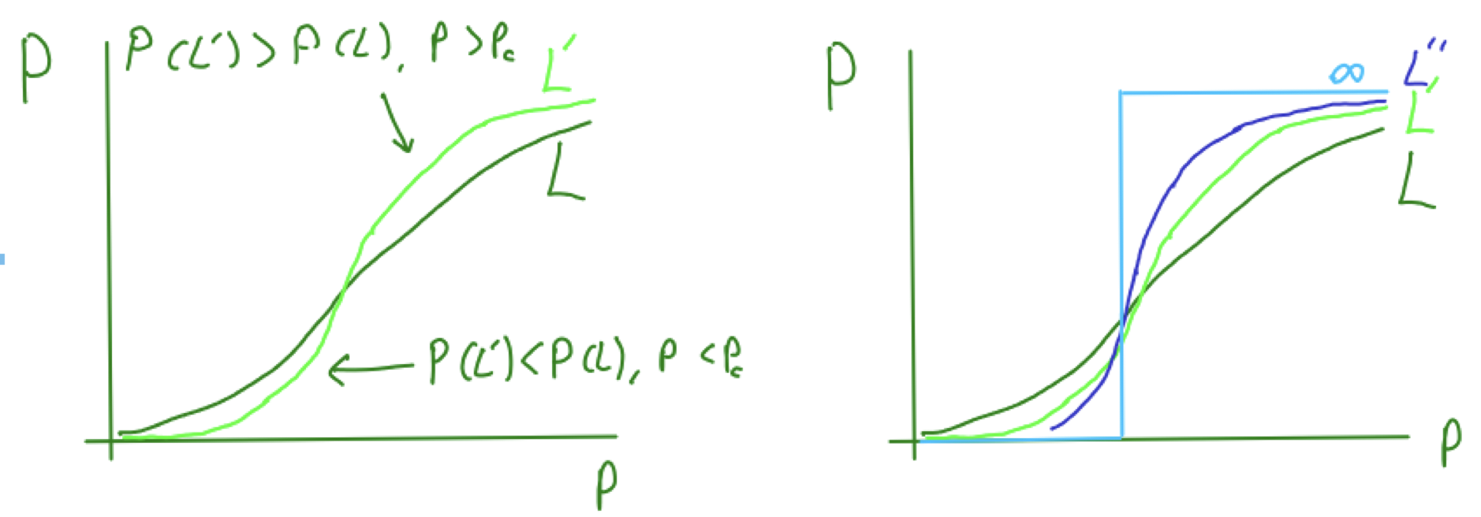
Threshold
Correcting according to the right class removes the effects of errors
Correcting according to the wrong class causes an operation on the encoded qubit (without our knowing)
What is the probability of such an error, P, given the probability on the qubits of the code, p?
We find a phase transition as L is increased (for an LxL grid)

Slide 29
More Logical Gates
We’ve seen how to do logical X and Z
A logical CX can be done without much trouble
A logical H requires the lattice to be rotated, but that can be done
Other logical Clifford gates can be done with some crazy tricks
But that’s all! No other logical operations can be done fault-tolerantly.
A solution is magic state distillation, using the logical gates we have to clean up the one we don’t
But that’s beyond today’s lecture…

Slide 30
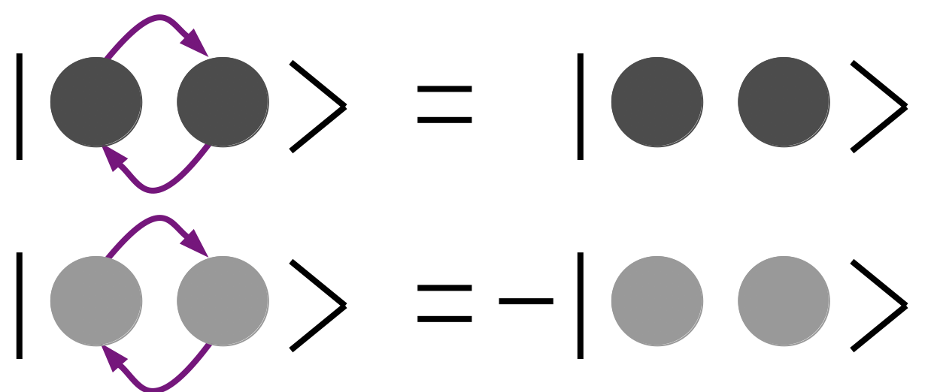
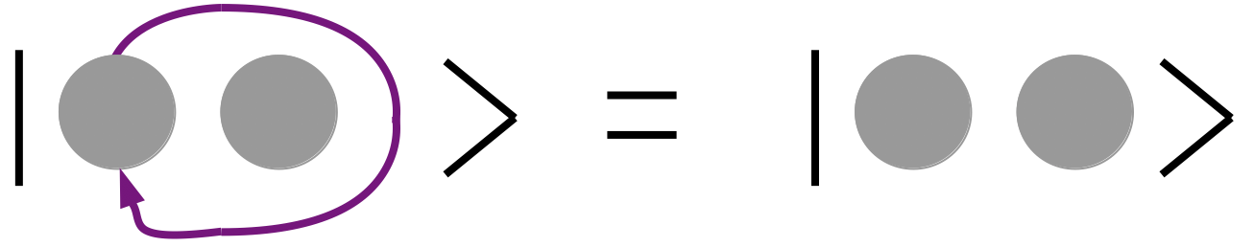
Anyons in the Surface Code
There are many variants on how qubits can be encoded and manipulated in the surface code
They all depend on the unique topological nature
The ‘defects’ created by errors in the surface code behave like particles
All particles in our universe are either bosons or fermions
This due to topological restrictions in a 3D universe

Slide 31
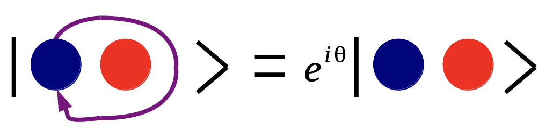
Anyons in the Surface Code
The surface code is only a 2D ‘universe’, so doesn’t have these restrictions
How do these particles behave?

Slide 32
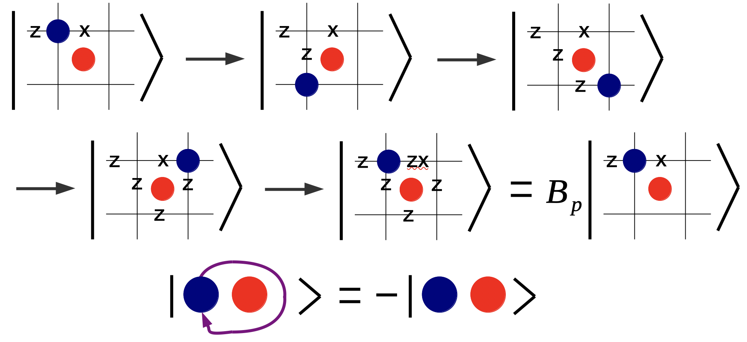
Anyons in the Surface Code
Braiding a particle corresponds to applying a stabilizer
Their eigenstates defines the braiding phase
Neither bosons nor fermions, but anyons!

